Slide 1
Technical Presentation
Comparing Growth Functions: Visualizing Algorithmic Complexity
Presented By:
P.Likith Vardhan 192365052

Slide 2
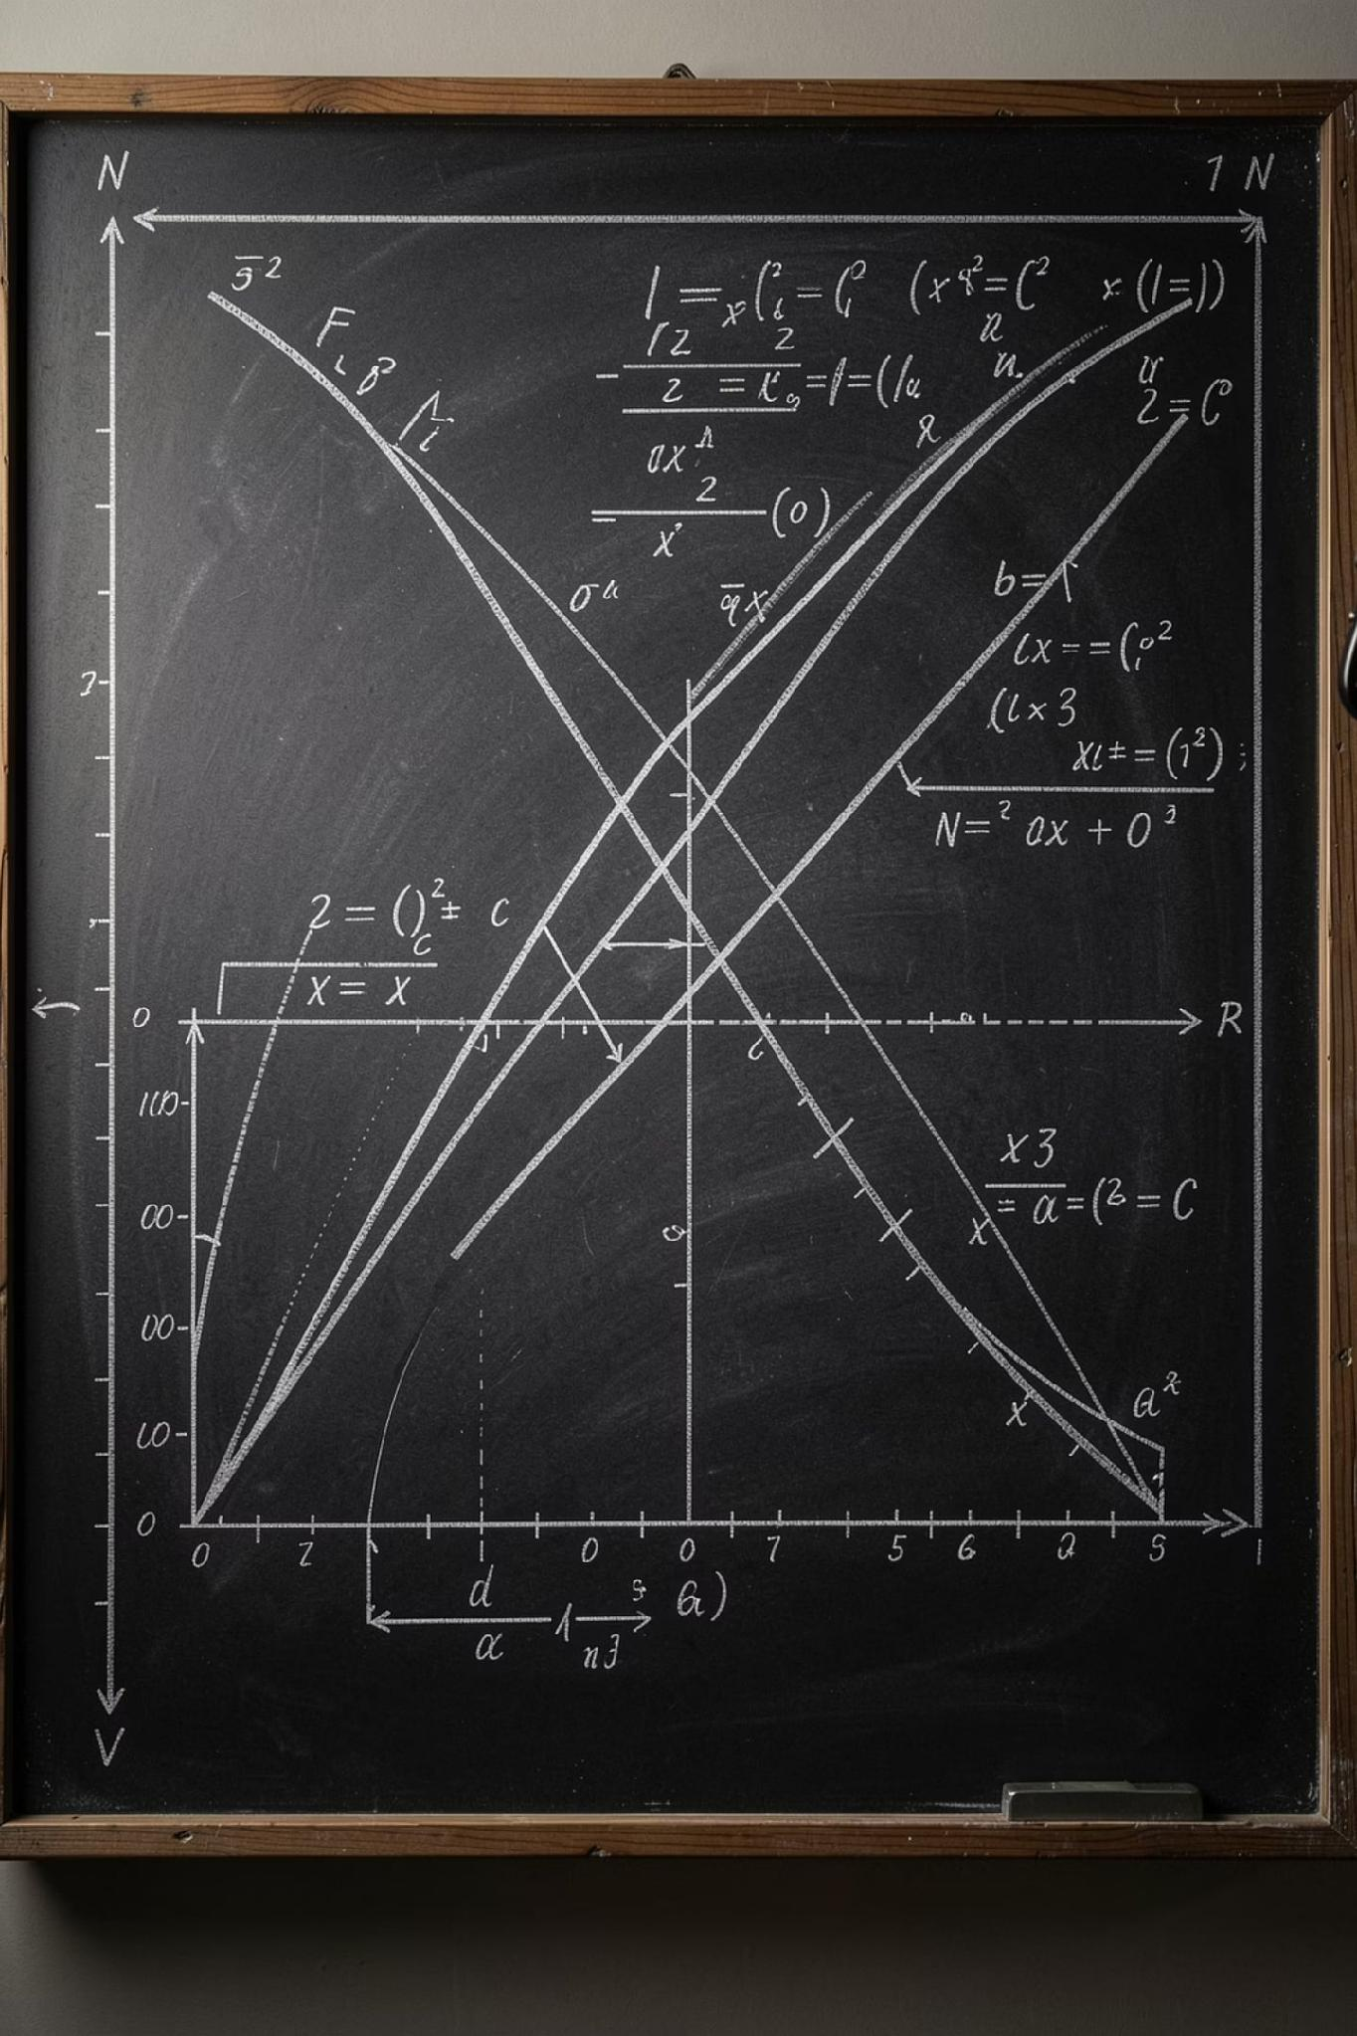
Purpose: To analyze O(log n), O(n), O(n log n), O(n²), and O(2ⁿ) using clear visualizations and concise technical interpretation. This deck helps engineers and decision-makers choose algorithms that remain practical as input sizes grow.

Slide 3


Why compare growth functions?
Comparing asymptotic growth provides intuition about how resource use (time or memory) scales with input size n. - Guides algorithm selection for different problem sizes and environments. - Highlights thresholds where an algorithm becomes impractical. - Complements empirical benchmarking by explaining theoretical limits.
This presentation focuses on asymptotic rates (big-O) rather than constant factors.

Slide 4





Definitions — the five growth rates
O(log n)
O(n)
O(n log n)
Time grows proportional to the logarithm of n. Typical for binary search and balanced-tree operations.
Time grows linearly with n. Seen in single-pass scans and simple aggregation.
Linearithmic growth; common in efficient comparison-based sorts (merge sort, heapsort).
O(n²)
O(2ⁿ)
Quadratic growth from nested loops; typical in naive pairwise comparisons.
Exponential growth; occurs in many naive combinatorial or brute-force search problems.

Slide 5
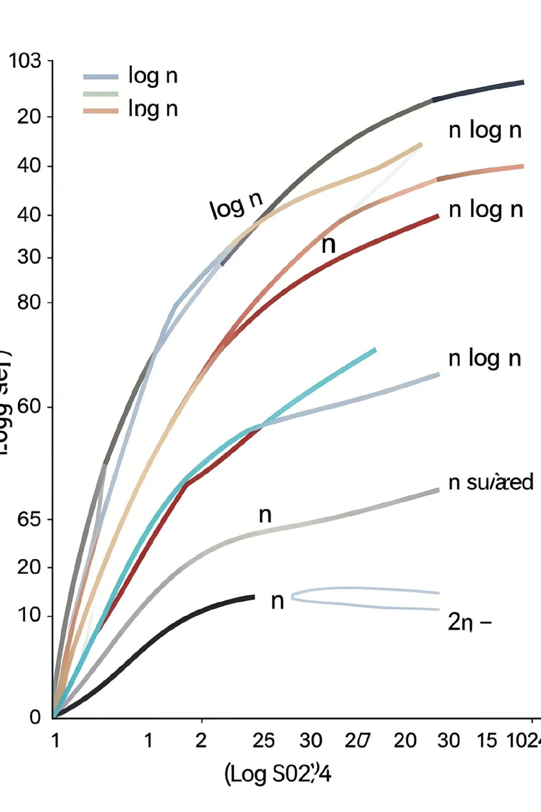
Visual comparison — growth curves
The chart visualizes relative growth on a wide input range. Note: horizontal axis spans small to very large n (log-scaled for readability). Curves diverge sharply: O(2ⁿ) becomes dominant very quickly; O(n²) overtakes linear rates for large n.

Slide 6
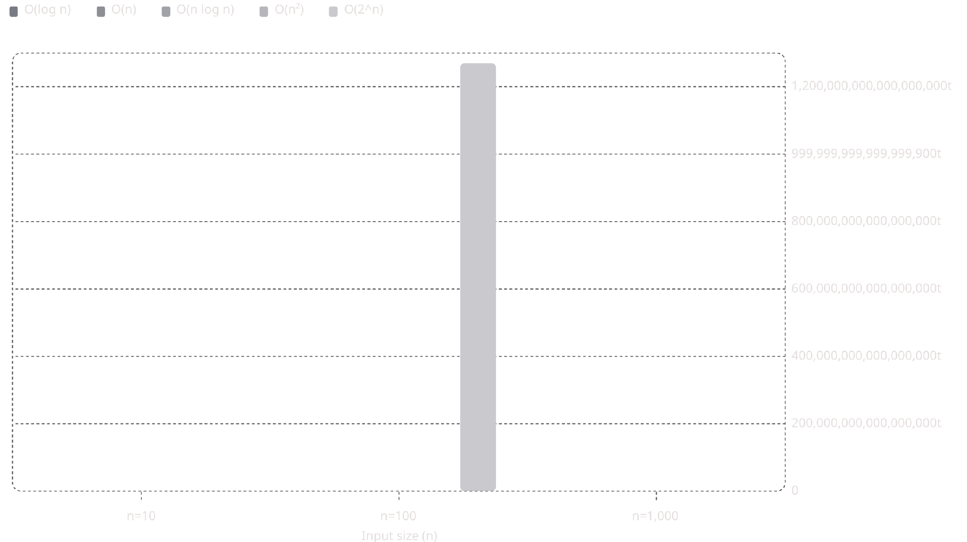
Quantitative snapshot — runtime at selected n
Note on units: column values are conceptual operation counts (log uses base-2 rounded). Exponential values quickly exceed representable ranges — shown here to emphasize impracticality.

Slide 7

Practicality thresholds
Heuristic guidance for algorithm selection by problem scale:
Small n (< 100): O(n²) may be acceptable if implementation simple and constants small.
Moderate n (100 — 100k): Prefer O(n log n) or O(n) for predictable performance.
Very large n (> 100k): O(n) or O(log n) are desirable; O(n log n) can still be acceptable depending on constants and memory.
Combinatorial problems: O(2ⁿ) is only feasible for n ≤ ~50 with heavy pruning or specialized algorithms.

Slide 8
When exponential appears — mitigation strategies
Algorithmic improvements
Approximation & heuristics
Use dynamic programming, memoization, or problem reductions to reduce exponential to polynomial when possible.
Accept near-optimal solutions (greedy, local search) when exact solution is infeasible.
Constraint pruning
Parallelism & hardware
Apply branch-and-bound, bounding functions, and domain constraints to cut search space drastically.
Distribute work and use GPUs/TPUs for exploitable parallel subproblems, but note asymptotic growth remains limiting.

Slide 9
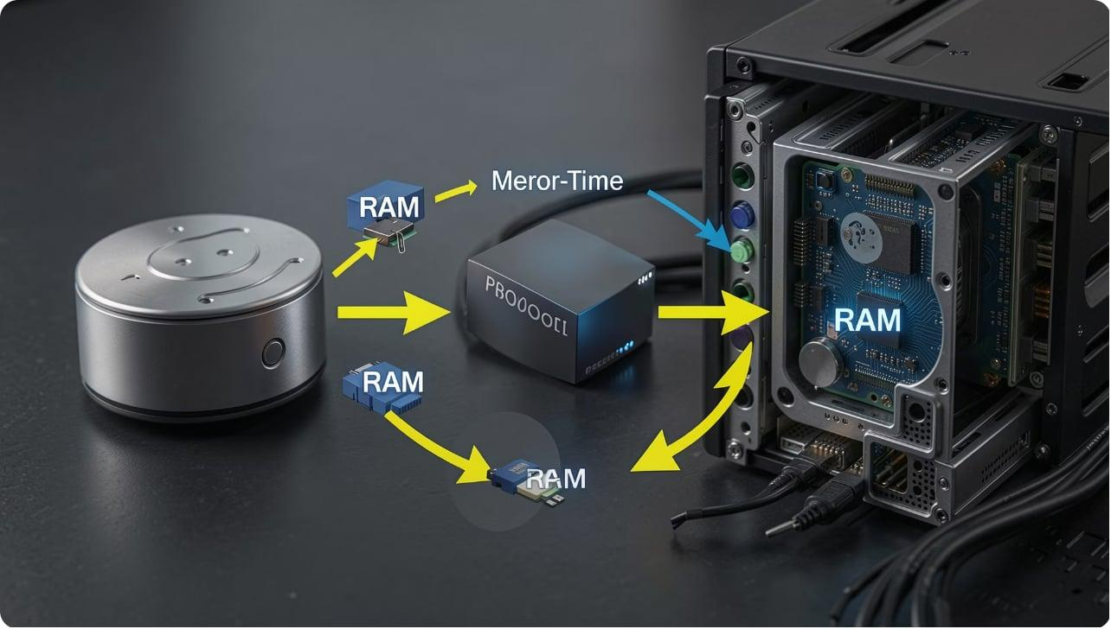
Space vs time trade-offs
Many optimizations trade memory for speed: - Memoization: increases space to reduce recomputation (time → from exponential to polynomial in some cases). - External memory algorithms: stream data to reduce RAM requirements, often increasing I/O cost. - Choose algorithms considering both time complexity and memory footprint for target environment.
Complexity class alone does not guarantee practical performance — constants, cache behavior, and I/O matter.

Slide 10

Summary — which functions scale?
O(log n)
O(n)
O(n log n)
Scales extremely well; preferred when available (indexed search, balanced trees).
Predictable and practical for large n; linear-time algorithms are often ideal for massive datasets.
Acceptable for most large-scale tasks (sorting, many divide-and-conquer algorithms).
O(n²)
O(2ⁿ)
Feasible only for small-to-moderate n; optimize or replace for large inputs.
Generally impractical beyond very small n; requires algorithmic transformation or approximation.

Slide 11

Conclusions & Recommendations
- Prefer O(log n) or O(n) for systems that must scale to millions of items. - Use O(n log n) as a practical compromise for sorting and many algorithms; optimize constants. - Replace or reengineer O(n²) and O(2ⁿ) solutions for large inputs: consider algorithmic redesign, DP, approximation, or problem relaxation. - Always complement asymptotic analysis with profiling on representative data and consider memory, I/O, and parallelism.
Next steps: benchmark candidate algorithms on real datasets, record wall-clock and memory, and validate assumptions about input distributions.

